Slide 1
COMP 2710 Software Construction
Pointers and Dynamic Arrays
Dr. Alvin Lim
Auburn University
http://www.eng.auburn.edu/~lim
limalvi@auburn.edu
Fall 2014
These slides are adapted from notes by Dr. Walter Savitch (UCSD)

Slide 2
Pointer Introduction
Pointer definition:
  Memory address of a variable
Recall: memory divided
  Numbered memory locations
  Addresses used as name for variable
You’ve used pointers already!
  Call-by-reference parameters
    Address of actual argument was passed
Copyright © 2008 Pearson Addison-Wesley. All rights reserved.
10-<number>

Slide 3
Pointer Variables
Pointers are "typed"
  Can store pointer in variable
  Not int, double, etc.
    Instead: A POINTER to int, double, etc.!
Example:
double *p;
  p is declared a "pointer to double" variable
  Can hold pointers to variables of type double
    Not other types!
Copyright © 2008 Pearson Addison-Wesley. All rights reserved.
10-<number>
Notes:
asterisk p

Slide 4
Declaring Pointer Variables
Pointers declared like other types
  Add "*" before variable name
  Produces "pointer to" that type
"*" must be before each variable
int *p1, *p2, v1, v2;
  p1, p2 hold pointers to int variables
  v1, v2 are ordinary int variables
Copyright © 2008 Pearson Addison-Wesley. All rights reserved.
10-<number>

Slide 5
Addresses and Numbers
Pointer is an address
Address is an integer
Pointer is NOT an integer!
  Not crazy → abstraction!
C++ forces pointers be used as
addresses
  Cannot be used as numbers
  Even though it "is a" number
Copyright © 2008 Pearson Addison-Wesley. All rights reserved.
10-<number>

Slide 6
Pointing
Terminology, view
  Talk of "pointing", not "addresses"
  Pointer variable "points to" ordinary variable
  Leave "address" talk out
Makes visualization clearer
  "See" memory references
    Arrows
Copyright © 2008 Pearson Addison-Wesley. All rights reserved.
10-<number>

Slide 7
An Example: Pointing to …
Example:
int *p1, *p2, v1, v2; //how to let p1 point to v1?
  Sets pointer variable p1 to "point to" int
  variable v1
Operator, &
  Determines "address of" variable
p1 = &v1;
Read like:
  "p1 equals address of v1"
  Or "p1 points to v1"
10-<number>

Slide 8
How to refer to …?
Recall:
int *p1, *p2, v1, v2;
p1 = &v1;
Two ways to refer to v1 now:
  Variable v1 itself:
  cout << v1;
  Via pointer p1:
  cout << *p1;
Dereference operator, *
  Pointer variable "derereferenced"
  Means: "Get data that p1 points to"
Copyright © 2008 Pearson Addison-Wesley. All rights reserved.
10-<number>

Slide 9
"Pointing to" Example
Consider:
v1 = 0;
p1 = &v1;
*p1 = 42;
cout << v1 << endl;
cout << *p1 << endl;
Produces output?
p1 and v1 refer to same variable
42
42
Copyright © 2008 Pearson Addison-Wesley. All rights reserved.
10-<number>

Slide 10
& Operator
The "address of" operator
Also used to specify call-by-reference
parameter
  No coincidence!
  Recall: call-by-reference parameters pass
  "address of" the actual argument
Operator’s two uses are closely related
Copyright © 2008 Pearson Addison-Wesley. All rights reserved.
10-<number>

Slide 11
Pointer Assignments
Pointer variables can be "assigned":
int *p1, *p2;
p2 = p1;
  Assigns one pointer to another
  "Make p2 point to where p1 points"
Do not confuse with:
*p1 = *p2;
  Assigns "value pointed to" by p1, to "value
  pointed to" by p2
Copyright © 2008 Pearson Addison-Wesley. All rights reserved.
10-<number>

Slide 12
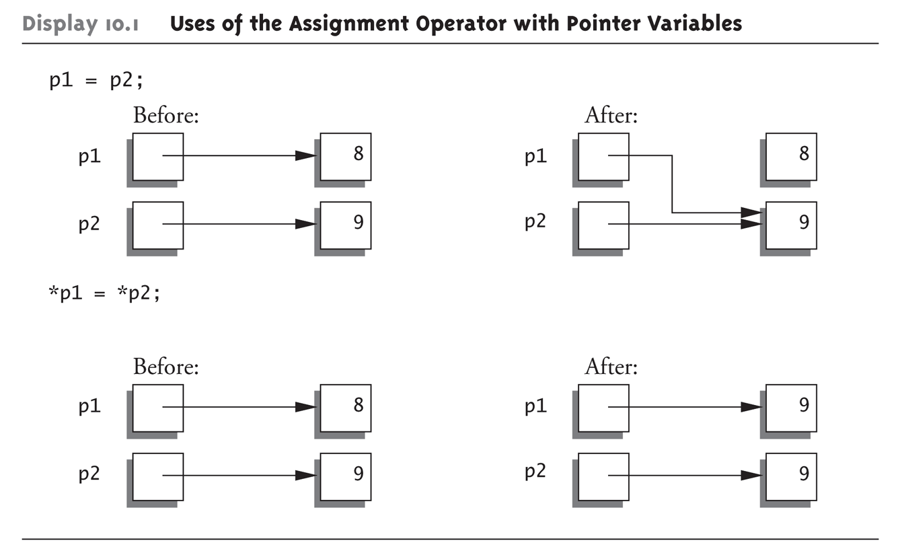
Pointer Assignments Graphic:
Display 10.1 Uses of the Assignment Operator with Pointer Variables
Copyright © 2008 Pearson Addison-Wesley. All rights reserved.
10-<number>
Notes:
Try this!

Slide 13
The new Operator
Since pointers can refer to variables…
  No "real" need to have a standard identifier
Can dynamically allocate variables
  Operator new creates variables
    No identifiers to refer to them
    Just a pointer!
p1 = new int;
  Creates new "nameless" variable, and
  assigns p1 to "point to" it
  Can access with *p1
    Use just like ordinary variable
Copyright © 2008 Pearson Addison-Wesley. All rights reserved.
10-<number>

Slide 14
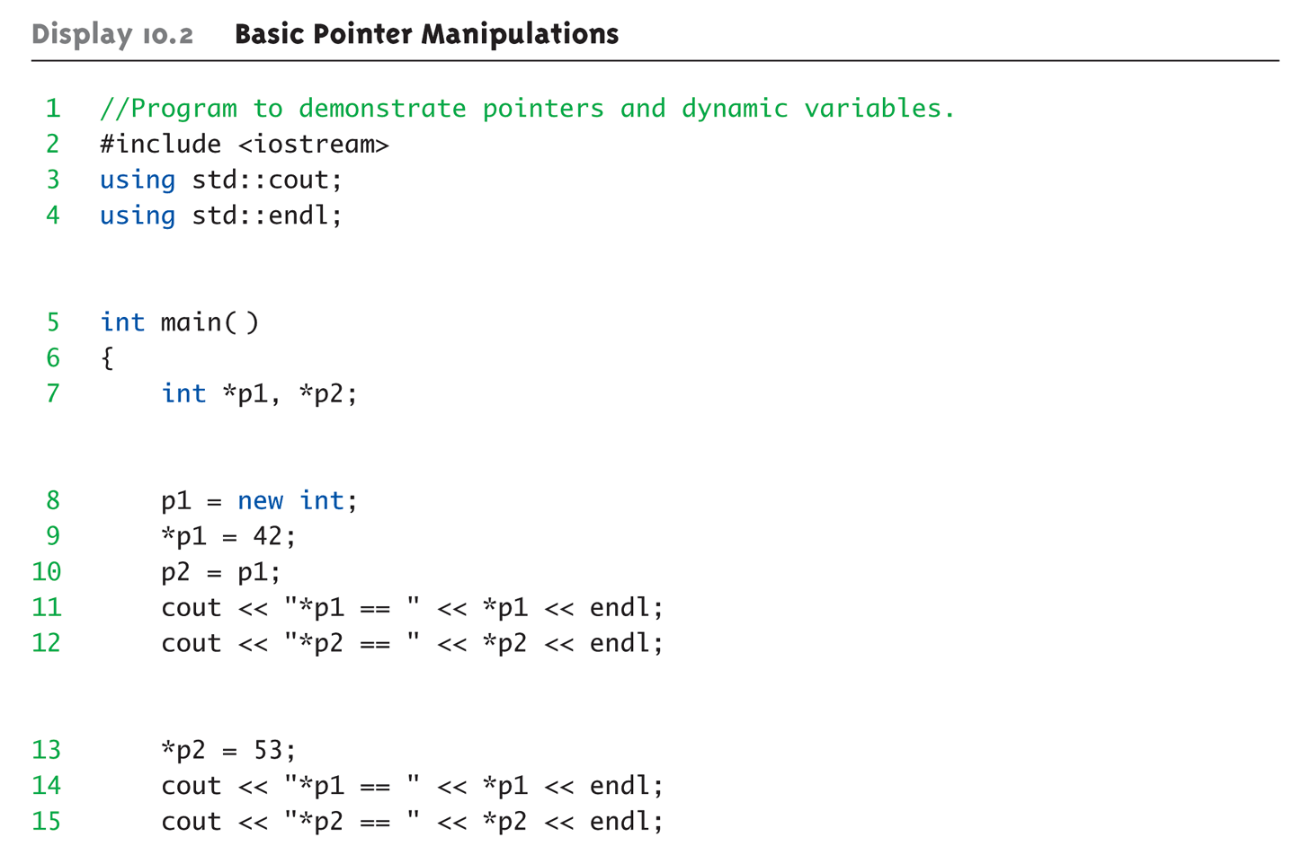
Basic Pointer Manipulations Example:
Display 10.2 Basic Pointer
Manipulations (1 of 2)
Copyright © 2008 Pearson Addison-Wesley. All rights reserved.
10-<number>
Notes:
Basicpointer.cpp

Slide 15
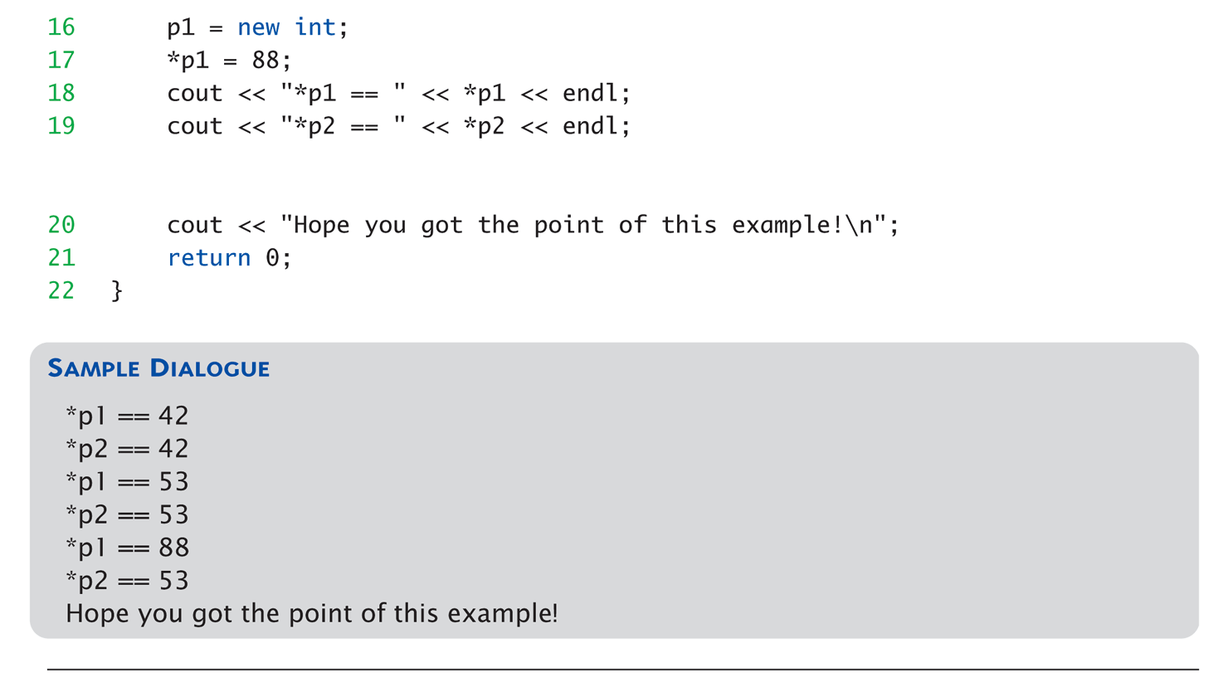
Basic Pointer Manipulations Example:
Display 10.2 Basic Pointer
Manipulations (2 of 2)
Copyright © 2008 Pearson Addison-Wesley. All rights reserved.
10-<number>

Slide 16
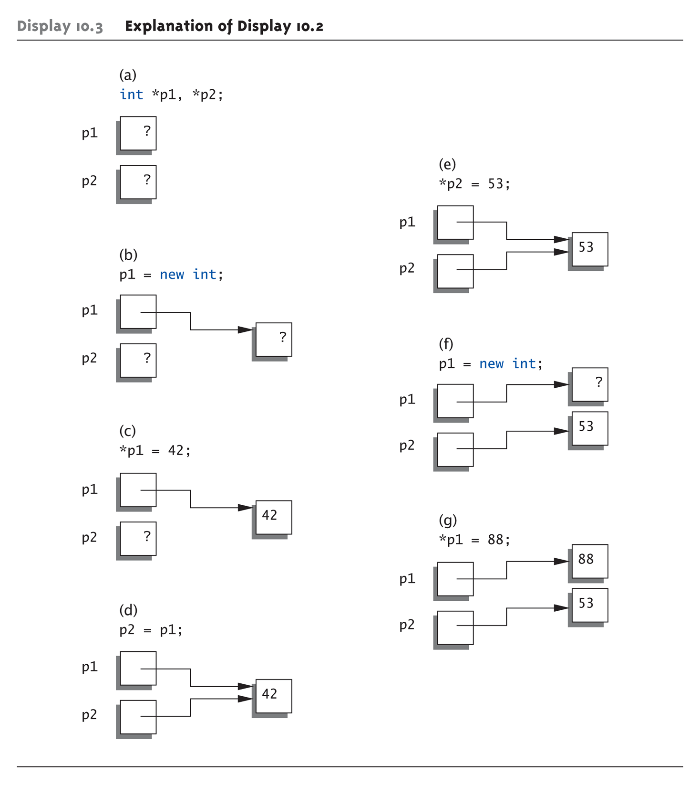
Basic Pointer Manipulations Graphic:
Display 10.3 Explanation of Display 10.2
Copyright © 2008 Pearson Addison-Wesley. All rights reserved.
10-<number>

Slide 17
More on new Operator
Creates new dynamic variable
Returns pointer to the new variable
If type is class type:
  Constructor is called for new object
  Can invoke different constructor with
  initializer arguments:
  MyClass *mcPtr;
  mcPtr = new MyClass(32.0, 17);
Can still initialize non-class types:
int *n;
n = new int(17); //Initializes *n to 17
Copyright © 2008 Pearson Addison-Wesley. All rights reserved.
10-<number>

Slide 18
Pointers and Functions
Pointers are full-fledged types
  Can be used just like other types
Can be function parameters
Can be returned from functions
Example:
int* findOtherPointer(int* p);
  This function declaration:
    Has "pointer to an int" parameter
    Returns "pointer to an int" variable
Copyright © 2008 Pearson Addison-Wesley. All rights reserved.
10-<number>

Slide 19
Memory Management
Heap
  Also called "freestore"
  Reserved for dynamically-allocated variables
  All new dynamic variables consume memory
  in freestore
    If too many → could use all freestore memory
Future "new" operations will fail if freestore
is "full"
Copyright © 2008 Pearson Addison-Wesley. All rights reserved.
10-<number>

Slide 20
Checking new Success
Older compilers:
  Test if null returned by call to new:
  int *p;
  p = new int;
  if (p == NULL)
  {
  cout << "Error: Insufficient memory.\n";
  exit(1);
  }
  If new succeeded, program continues
Copyright © 2008 Pearson Addison-Wesley. All rights reserved.
10-<number>

Slide 21
new Success – New Compiler
Newer compilers:
  If new operation fails:
    Program terminates automatically
    Produces error message
Still good practice to use NULL check
Copyright © 2008 Pearson Addison-Wesley. All rights reserved.
10-<number>

Slide 22
Freestore Size
Varies with implementations
Typically large
  Most programs won’t use all memory
Memory management
  Still good practice
  Solid software engineering principle
  Memory IS finite
    Regardless of how much there is!
Copyright © 2008 Pearson Addison-Wesley. All rights reserved.
10-<number>

Slide 23
delete Operator
Why?
De-allocate dynamic memory
  When no longer needed
  Returns memory to freestore
  Example:
  int *p;
  p = new int(5);
  … //Some processing…
  delete p;
  De-allocates dynamic memory "pointed to by
  pointer p"
    Literally "destroys" memory
Copyright © 2008 Pearson Addison-Wesley. All rights reserved.
10-<number>

Slide 24
Dangling Pointers
delete p;
  Destroys dynamic memory
  But p still points there!
    Called "dangling pointer"
  If p is then dereferenced ( *p )
    Unpredicatable results!
    Often disastrous!
Avoid dangling pointers
  Assign pointer to NULL after delete:
  delete p;
  p = NULL;
Copyright © 2008 Pearson Addison-Wesley. All rights reserved.
10-<number>

Slide 25
Dynamic and Automatic Variables
Dynamic variables
  Created with new operator
  Created and destroyed while program runs
Local variables
  Declared within function definition
  Not dynamic
    Created when function is called
    Destroyed when function call completes
  Often called "automatic" variables
    Properties controlled for you
Copyright © 2008 Pearson Addison-Wesley. All rights reserved.
10-<number>

Slide 26
Define Pointer Types
Can "name" pointer types
To be able to declare pointers like other
variables
  Eliminate need for "*" in pointer declaration
typedef int* IntPtr;
  Defines a "new type" alias
  Consider these declarations:
  IntPtr p;
  int *p;
    The two are equivalent
Copyright © 2008 Pearson Addison-Wesley. All rights reserved.
10-<number>

Slide 27
Pitfall: Call-by-value Pointers
Behavior subtle and troublesome
  If function changes pointer parameter
  itself → only change is to local copy
Best illustrated with example…
Copyright © 2008 Pearson Addison-Wesley. All rights reserved.
10-<number>

Slide 28
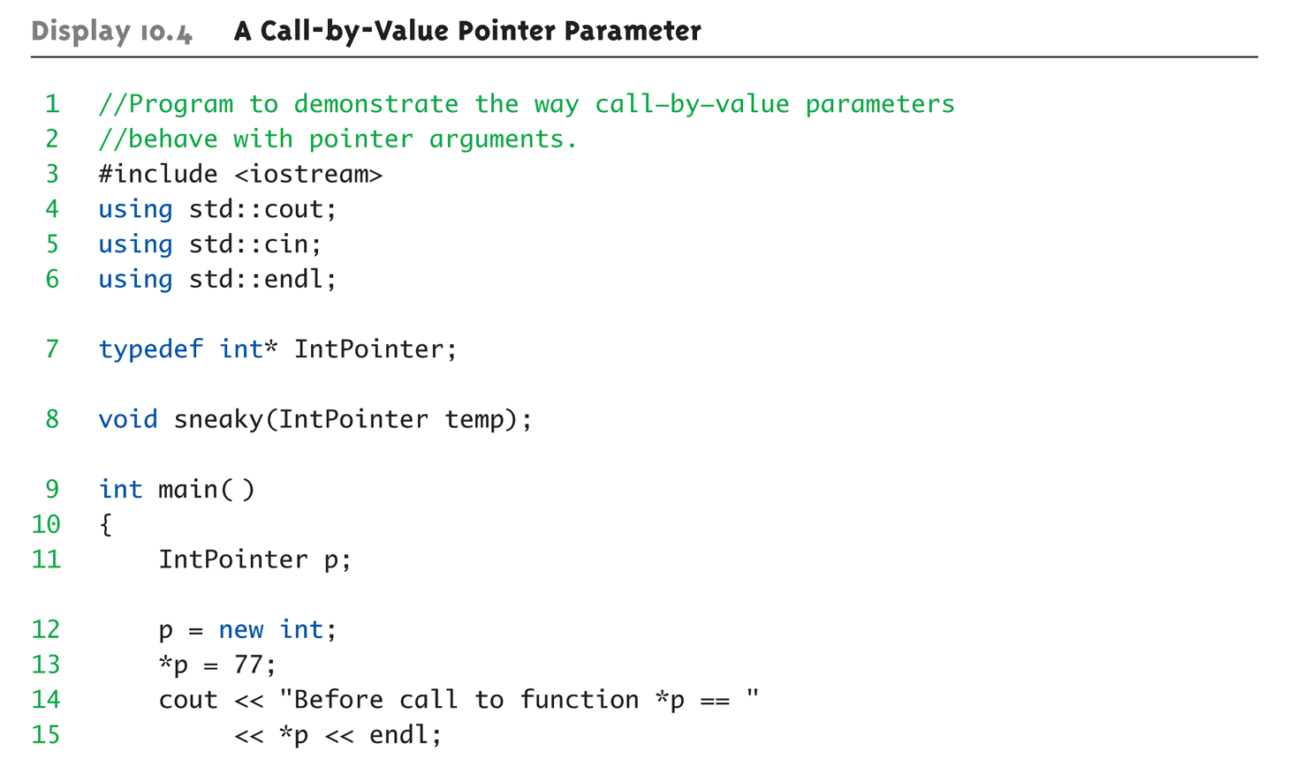
Call-by-value Pointers Example:
Display 10.4 A Call-by-Value Pointer Parameter (1 of 2)
Copyright © 2008 Pearson Addison-Wesley. All rights reserved.
10-<number>
Notes:
10-04.cpp

Slide 29
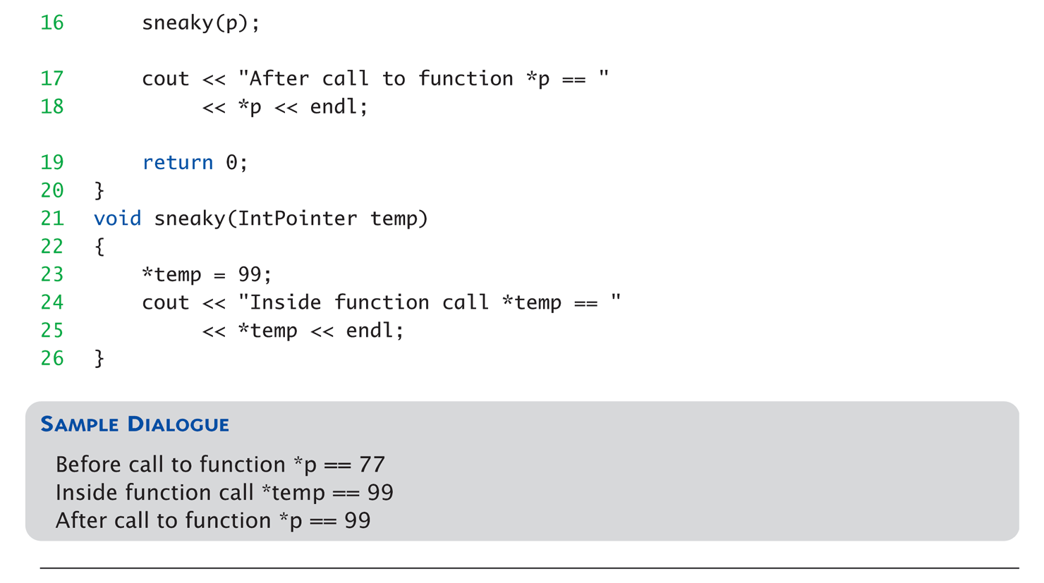
Call-by-value Pointers Example:
Display 10.4 A Call-by-Value Pointer Parameter (2 of 2)
Copyright © 2008 Pearson Addison-Wesley. All rights reserved.
10-<number>

Slide 30
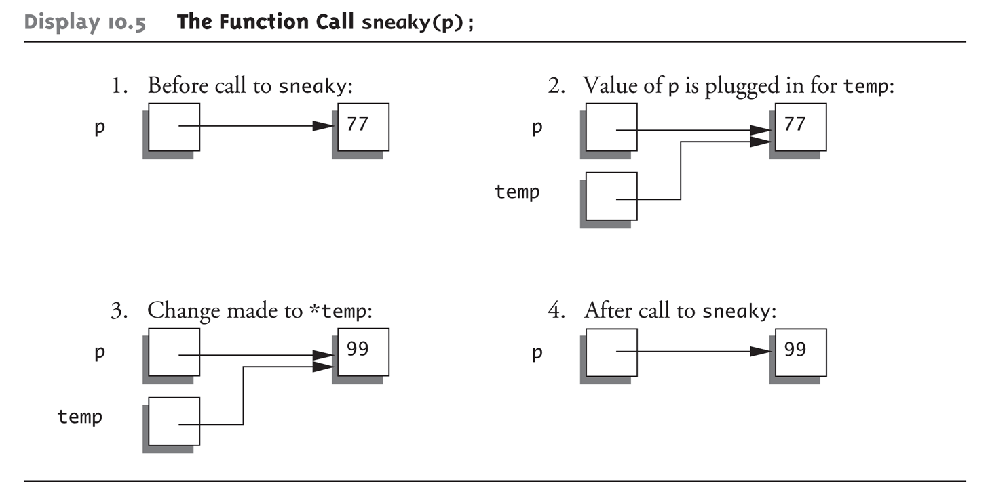
Call-by-value Pointers Graphic:
Display 10.5 The Function Call sneaky(p);
Copyright © 2008 Pearson Addison-Wesley. All rights reserved.
10-<number>

Slide 31
Dynamic Arrays
Array variables
  Really pointer variables!
Standard array
  Fixed size
Dynamic array
  Size not specified at programming time
  Determined while program running
Copyright © 2008 Pearson Addison-Wesley. All rights reserved.
10-<number>

Slide 32
Array Variables
Recall: arrays stored in memory addresses, sequentially
  Array variable "refers to" first indexed variable
  So array variable is a kind of pointer variable!
Example:
int a[10];
int * p;
  a and p are both pointer variables!
Copyright © 2008 Pearson Addison-Wesley. All rights reserved.
10-<number>

Slide 33
Array Variables → Pointers
Recall previous example:
int a[10];
typedef int* IntPtr;
IntPtr p;
a and p are pointer variables
  Can perform assignments:
  p = a; // Legal.
    p now points where a points
      To first indexed variable of array a
  a = p; // ILLEGAL!
    Array pointer is CONSTANT pointer!
Copyright © 2008 Pearson Addison-Wesley. All rights reserved.
10-<number>

Slide 34
Array Variables → Pointers
Array variable
int a[10];
MORE than a pointer variable
  "const int *" type
  Array was allocated in memory already
  Variable a MUST point there…always!
    Cannot be changed!
In contrast to ordinary pointers
  Which can (& typically do) change
Copyright © 2008 Pearson Addison-Wesley. All rights reserved.
10-<number>

Slide 35
Dynamic Arrays
Array limitations
  Must specify size first
  May not know until program runs!
Must "estimate" maximum size needed
  Sometimes OK, sometimes not
  "Wastes" memory
Dynamic arrays
  Can grow and shrink as needed
Copyright © 2008 Pearson Addison-Wesley. All rights reserved.
10-<number>

Slide 36
Creating Dynamic Arrays
Very simple!
Use new operator
  Dynamically allocate with pointer variable
  Treat like standard arrays
Example:
typedef double * DoublePtr;
DoublePtr d;
d = new double[10]; //Size in brackets
  Creates dynamically allocated array variable d,
  with ten elements, base type double
Copyright © 2008 Pearson Addison-Wesley. All rights reserved.
10-<number>

Slide 37
Deleting Dynamic Arrays
Allocated dynamically at run-time
  So should be destroyed at run-time
Simple again. Recall Example:
d = new double[10];
… //Processing
delete [] d;
  De-allocates all memory for dynamic array
  Brackets indicate "array" is there
  Recall: d still points there!
    Should set d = NULL;
Copyright © 2008 Pearson Addison-Wesley. All rights reserved.
10-<number>

Slide 38
Function that Returns an Array
Array type NOT allowed as return-type
of function
Example:
int [] someFunction(); // ILLEGAL!
Instead return pointer to array base type:
int* someFunction(); // LEGAL!
Copyright © 2008 Pearson Addison-Wesley. All rights reserved.
10-<number>

Slide 39
Pointer Arithmetic
Can perform arithmetic on pointers
  "Address" arithmetic
Example:
typedef double* DoublePtr;
DoublePtr d;
d = new double[10];
  d contains address of d[0]
  d + 1 evaluates to address of d[1]
  d + 2 evaluates to address of d[2]
    Equates to "address" at these locations
Copyright © 2008 Pearson Addison-Wesley. All rights reserved.
10-<number>

Slide 40
Alternative Array Manipulation
Use pointer arithmetic!
"Step thru" array without indexing:
for (int i = 0; i < arraySize; i++)
cout << *(d + i) << " " ;
Equivalent to:
for (int i = 0; i < arraySize; i++)
cout << d[i] << " " ;
Only addition/subtraction on pointers
  No multiplication, division
Can use ++ and -- on pointers
Copyright © 2008 Pearson Addison-Wesley. All rights reserved.
10-<number>

Slide 41
Multidimensional Dynamic Arrays
Yes we can!
Recall: "arrays of arrays"
Type definitions help "see it":
typedef int* IntArrayPtr;
IntArrayPtr *m = new IntArrayPtr[3];
  Creates array of three pointers
  Make each allocate array of 4 ints
for (int i = 0; i < 3; i++)
m[i] = new int[4];
  Results in three-by-four dynamic array!
Copyright © 2008 Pearson Addison-Wesley. All rights reserved.
10-<number>

Slide 42
Back to Classes
The -> operator
  Shorthand notation
Combines dereference operator, *, and
dot operator
Specifies member of class "pointed to"
by given pointer
Example:
MyClass *p;
p = new MyClass;
p->grade = "A"; Equivalent to:
(*p).grade = "A";
Copyright © 2008 Pearson Addison-Wesley. All rights reserved.
10-<number>

Slide 43
The this Pointer
Member function definitions might need to refer to calling object
Use predefined this pointer
  Automatically points to calling object:
  Class Simple
  {
  public:
  void showStuff() const;
  private:
  int stuff;
  };
Two ways for member functions to access:
cout << stuff;
cout << this->stuff;
Copyright © 2008 Pearson Addison-Wesley. All rights reserved.
10-<number>

Slide 44
Overloading Assignment Operator
Assignment operator returns reference
  So assignment "chains" are possible
  e.g., a = b = c;
    Sets a and b equal to c
Operator must return "same type" as it’s
left-hand side
  To allow chains to work
  The this pointer will help with this!
Copyright © 2008 Pearson Addison-Wesley. All rights reserved.
10-<number>

Slide 45
Overloading Assignment Operator
Recall: Assignment operator must be
member of the class
  It has one parameter
  Left-operand is calling object
  s1 = s2;
    Think of like: s1.=(s2);
s1 = s2 = s3;
  Requires (s1 = s2) = s3;
  So (s1 = s2) must return object of s1"s type
    And pass to " = s3";
Copyright © 2008 Pearson Addison-Wesley. All rights reserved.
10-<number>

Slide 46
Overloaded = Operator Definition
Uses string Class example:
StringClass& StringClass::operator=(const StringClass& rtSide)
{
if (this == &rtSide) // if right side same as left side
return *this;
else
{
capacity = rtSide.capacity;
length = rtSide.length;
delete [] a;
a = new char[capacity];
for (int i = 0; i < length; i++)
a[i] = rtSide.a[i];
return *this;
}
}
Copyright © 2008 Pearson Addison-Wesley. All rights reserved.
10-<number>

Slide 47
Shallow and Deep Copies
Shallow copy
  Assignment copies only member variable
  contents over
  Default assignment and copy constructors
Deep copy
  Pointers, dynamic memory involved
  Must dereference pointer variables to
  "get to" data for copying
  Write your own assignment overload and
  copy constructor in this case!
Copyright © 2008 Pearson Addison-Wesley. All rights reserved.
10-<number>

Slide 48
Copy Constructors
A copy constructor is a constructor that has one parameter that is of the same type as the class
Automatically called when:
  Class object declared and initialized to other object
  When function returns class type object
  When argument of class type is "plugged in"
  as actual argument to call-by-value parameter
Requires "temporary copy" of object
  Copy constructor creates it
Default copy constructor
  Like default "=", performs member-wise copy
Pointers → write own copy constructor!
Copyright © 2008 Pearson Addison-Wesley. All rights reserved.
10-<number>

Slide 49
Copy Constructors Example
//Objects of this class are partially filled arrays of doubles.
class PFArrayD
{
public:
PFArrayD( );
//Initializes with a capacity of 50.
PFArrayD(int capacityValue);
PFArrayD(const PFArrayD& pfaObject); // Copy Constructor
void addElement(double element);
bool full( ) const { return (capacity == used); }
//Returns true if the array is full, false otherwise.
int getCapacity( ) const { return capacity; }
int getNumberUsed( ) const { return used; }
void emptyArray( ){ used = 0; }
//Empties the array.
double& operator[](int index);
//Read and change access to elements 0 through numberUsed - 1.
PFArrayD& operator =(const PFArrayD& rightSide); //Overloaded Assignment
~PFArrayD( ); // Destructor
private:
double *a; //for an array of doubles.
int capacity; //for the size of the array.
int used; //for the number of array positions currently in use.
};
Copyright © 2008 Pearson Addison-Wesley. All rights reserved.
10-<number>

Slide 50
Copy Constructors Definition
PFArrayD::PFArrayD(const PFArrayD& pfaObject)
:capacity(pfaObject.getCapacity( )), used(pfaObject.getNumberUsed( ))
{
a = new double[capacity];
for (int i =0; i < used; i++)
a[i] = pfaObject.a[i];
}
Example of main() program:
PFArrayD b(20);
For (int i = 0; i < 20; i++)
b.addElement(i);
PFArrayD temp(b); // Initialized by the copy constructor
Copyright © 2008 Pearson Addison-Wesley. All rights reserved.
10-<number>

Slide 51
Destructor Need
Dynamically-allocated variables
  Do not go away until "deleted"
If pointers are only private member data
  They dynamically allocate "real" data
    In constructor
  Must have means to "deallocate" when
  object is destroyed
Answer: destructor!
Copyright © 2008 Pearson Addison-Wesley. All rights reserved.
10-<number>

Slide 52
Destructors
Opposite of constructor
  Automatically called when object is out-of-scope
  Default version only removes ordinary
  variables, not dynamic variables
Defined like constructor, just add ~
  MyClass::~MyClass()
  {
  //Perform delete clean-up duties
  }
Copyright © 2008 Pearson Addison-Wesley. All rights reserved.
10-<number>

Slide 53
Summary 1
Pointer is memory address (plus type)
  Provides indirect reference to variable
Dynamic variables
  Created and destroyed while program runs
Freestore
  Memory storage for dynamic variables
Dynamically allocated arrays
  Size determined as program runs
Copyright © 2008 Pearson Addison-Wesley. All rights reserved.
10-<number>

Slide 54
Summary 2
Class destructor
  Special member function
  Automatically destroys objects
Copy constructor
  Single argument member function
  Called automatically when temp copy needed
Assignment operator
  Must be overloaded as member function
  Returns reference for chaining
Copyright © 2008 Pearson Addison-Wesley. All rights reserved.
10-<number>

